Slide 1
EDA of NYC Government Job Postings
Trends, Salaries, Skills, and Hiring Patterns
Group 5: Zaid Mohammad, Zhuowen Yan

Slide 2
Abstract
Objective: To explore NYC Government job postings and provide useful insights for job seekers.
This Exploratory Data Analysis (EDA) project examines over 5,000 NYC government job postings from 2021 to November 2024, offering key insights for job seekers.
By analyzing job categories, salary distributions, career levels, and in-demand skills, the study highlights high-demand fields is Engineering. Roles in Technology, Research, and Legal Affairs show some of the highest starting salaries, while communication skills and Microsoft Office are skills common requirements. The analysis also shows seasonal hiring peaks from September to early November, likely linked to fiscal cycles.
These findings aim to help job seekers align their career planning and skills with NYC’s Government employers needs.

Slide 3
Introduction
NYC Job Market Overview:
Wide range of career opportunities, especially in government.
Important for people interested in public service roles.
Target Audience:
Who Benefits?: People who seeking public service jobs.
Value: Align career planning with NYC job market needs.
Key Questions:
High-Demand Fields: Which job categories are in demand?
Salary Ranges: What are typical salary expectations?
Required Skills: What skills are most valued by NYC government?
Seasonal Trends: Are there peak times for job postings?
Analysis Methods:
Data Pre-processing: Filtered unneccessary data, standardized salaries, extracted time-based features.
Analysis Methods: Used univariate and bivariate analyses, plus text analysis for skills.

Slide 4
Dataset Overview
Source and Size:
Source: NYC Open Data Portal (NYC Jobs Dataset).
Dataset Size: 5,459 rows and 30 columns (each row represents a unique job posting).
Key Attributes:
Job Information: Job Category, Agency, Career Level.
Salary Information: Salary Range (From/To), Salary Frequency.
Qualifications and Skills: Minimum Requirements, Preferred Skills.
Time Information: Posting Date, Post Until Date.

Slide 5
Literature Review
Context of Related Research:
Explores past studies on job market trends, skill needs, and career planning.
Shows how data analysis supports job seekers in making better decisions.
Job Market Trends:
Bureau of Labor Statistics (BLS) shows industry growth and job demand [1].
Helps job seekers target high-demand sectors.
Skills Analysis:
LinkedIn Economic Graph research identifies in-demand skills.
Matches our approach of finding key qualifications in NYC postings.

Slide 6
Literature Review
Salary Analysis:
Government jobs have structured pay scales based on career level.
Higher career levels offer higher starting salaries.
Seasonal Trends:
Research on labor economics indicates seasonal hiring trends [1].
Our analysis explores similar seasonal trends for NYC government jobs.
Data-Driven Career Planning:
Platforms like Indeed and Glassdoor use data for career advice.
Our EDA provides actionable insights on skills, salary, and high-demand fields.

Slide 7
Methodology: Tools and Overview
Tools Used
Python: Main language for analysis.
Pandas: Data handling, cleaning, and preparation.
NumPy: Math operations (e.g., Z-score calculations).
Matplotlib & Seaborn: Create charts and graphs.
Scikit-Learn: CountVectorizer for text analysis to identify key skills.
Methodology Overview
Data Cleaning: Remove unnecessary parts and standardize.
Transformation: Prepare the data for effective analysis.
Analysis and Visualization: Extract patterns and trends for presentation.

Slide 8
Methodology: Pre-processing
Cleaning
Remove Duplicates: Eliminated duplicate job postings to ensure data uniqueness.
Drop Irrelevant Columns: Removed unnecessary columns like Recruitment Contact and Division/Work Unit.
Handle Missing Values: Filled missing values in Minimum Qualifications and Preferred Skills with empty strings to support text analysis.
Processing
Standardize Salaries: Converted Hourly and Monthly salaries to an annual basis for consistency.
Remove Part-Time & Student Jobs: Removed part-time jobs and roles with career level as “Student”.
Remove Outliers: Used Z-score to eliminate unrealistic salary data.
Feature Engineering
Extract Temporal Features: Created Posting Year and Month for trend analysis.
Create Salary Bins: Categorized salaries as Low, Medium, High, Very High to simplify comparisons.
Map Career Levels: Converted Career Level to numeric values for correlation analysis.
Simplify Job Categories: Consolidated similar categories by using shorter names.

Slide 9
Methodology: Analysis & Visualization
Data Analysis Techniques:
Univariate Analysis: Individual variables and their distributions.
Example: Job categories, career levels, salary ranges.
Bivariate Analysis: Relationships between two variables.
Example: Starting salary by career level, salaries by job category.
Multivariate Analysis: Relationships among multiple variables.
Correlation Heatmap: Career level and salary range relationships.
Time Series Analysis: Trends by year and month to find hiring peaks.
Text Analysis: Used CountVectorizer to extract common skills and qualifications.
Data Visualization:
Bar Charts: Distribution of job categories, skills, salary ranges.
Box & Violin Plots: Salary by career level and job category.
Heatmaps: Correlations between variables (e.g., career level and salary).
Line Plots: Trends in job postings by month/year.
Steps of Analysis:
Load and Inspect Data.
Pre-process Data.
Univariate and Bivariate Analysis.
Time Series & Text Analysis.
Visualization.

Slide 10
Data Cleaning
Checking and Removing Duplicate Rows:
Identified and removed duplicate job postings.
Ensured each job posting was unique, reducing redundancy in the dataset.
Dropping Irrelevant Columns:
Removed unnecessary columns such as Recruitment Contact, Division/Work Unit, To Apply, and Post Until.
Retained only columns relevant to analysis to reduce noise
Handling Missing Values:
Filled missing values in Minimum Qualifications and Preferred Skills with empty strings to prevent issues in text-based analysis.

Slide 11
Data Pre-processing
Standardizing Salary Information:
Converted Hourly and Monthly rates to annual equivalents:
Hourly: multiplied by 2,080 (standard work hours/year).
Monthly: multiplied by 12.
Ensured salaries are consistent and comparable on an annual basis.
Dropping Part-Time Jobs:
Removed part-time jobs (0.2% of dataset).
Focused only on full-time jobs for clearer insights on main job opportunities.
Remove rows where career level is “Student”:
To maintain focus on professional roles, rows with Career Level as “Student” were removed.
Removing Outliers:
Applied Z-score method to detect unrealistic salary values.
Removed outliers to focus on realistic salary ranges, improving accuracy.

Slide 12
Feature Engineering
Extract Temporal Features:
Created Posting Year and Posting Month from Posting Date.
Allowed for easy identification of hiring trends by month and year.
Creating Salary Bins:
Created salary categories for easier analysis:
Low (0–50k), Medium (50k–100k), High (100k–150k), Very High (150k–300k).
Simplified comparison across different salary levels.
Map Career Levels to Numeric Values:
The Career level feature was converted to numeric values to facilitate correlation analysis.
Entry- Level: 1 , Experienced(non-manager): 2, Manager: 3, Executive: 4
Simplify Job Categories:
For each group of similar categories, the shortest category name was identified and used to represent the entire group.

Slide 13
Data Visualization and Results
01
Univariate Analysis

Slide 14
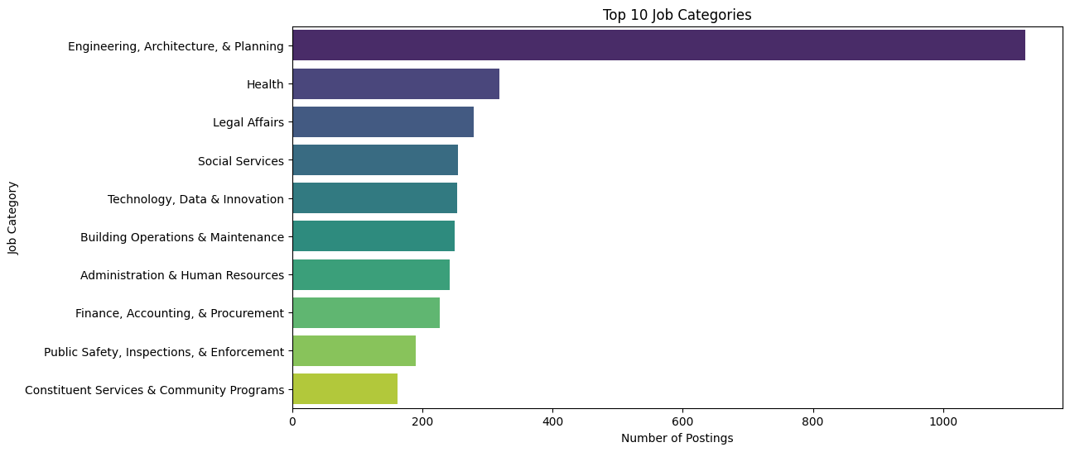
Figure 1.1. Top 10 Job Categories
The distribution of job categories shows that the most in-demand field is Engineering, Architecture & Planning. Engineering roles are particularly common, highlighting a high demand for technical skills in city projects and infrastructure. Other important fields like Health, Legal Affairs, and Social Services show the city’s need for professionals to support public health and welfare.

Slide 15
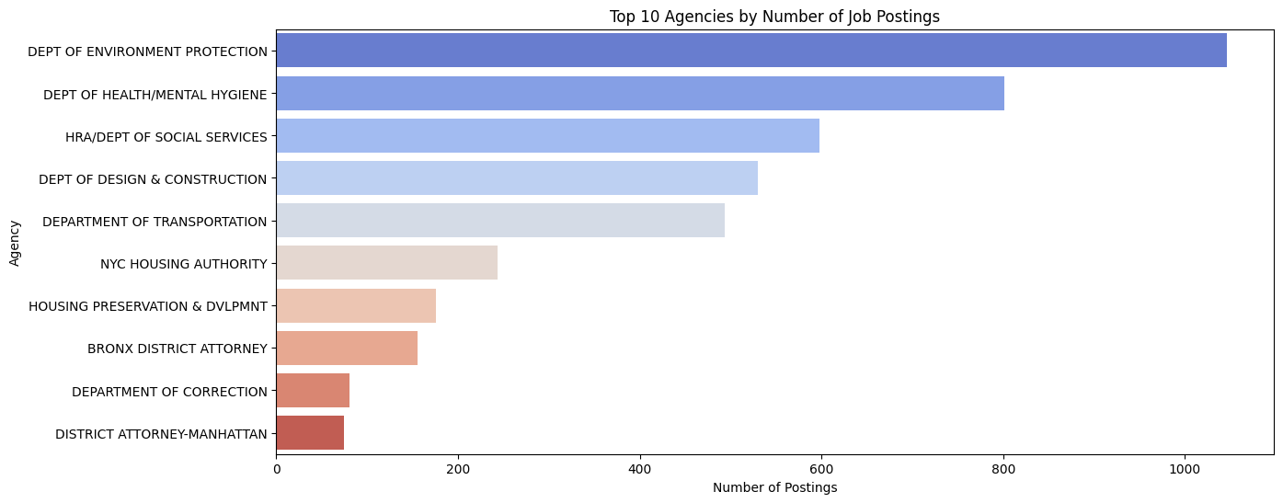
Figure 1.2. Top 10 Agencies
The analysis of job postings by agency shows hiring patterns, with the Dept of Environmental Protection, Dept of Health/Mental Hygiene, HRA/Department of Social Services, Dept of Designing & Construction, and Dept of Transportation having the most open positions. This means these agencies are key employers in the NYC public sector, likely because of their essential services that need continuous staffing.

Slide 16
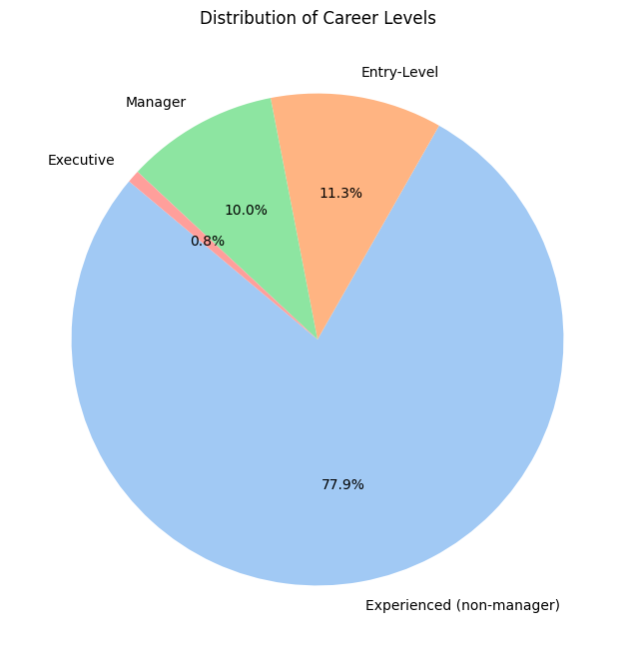
Figure 1.3. Distribution of Career Levels
The career level distribution shows that most jobs are for Experienced (non-manager) roles, which make up 78% of the listings. This is followed by Entry-level and Manager positions, with executive roles being the least common. The high number of experienced roles suggests that NYC agencies prefer people with relevant past experience, likely due to the demands of public service jobs.

Slide 17
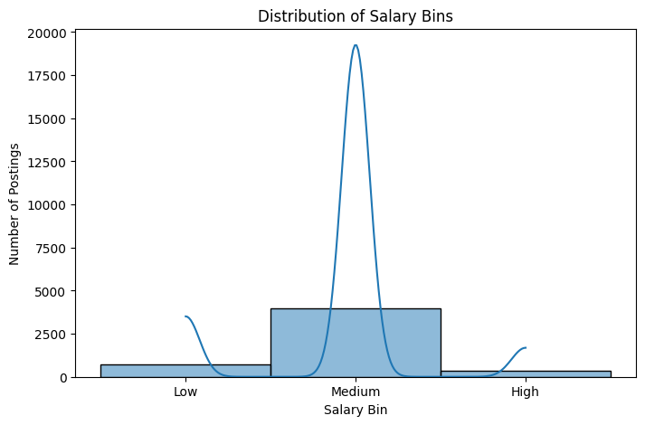
Figure 1.4. Distribution of Salary Bins
The majority of jobs fall into the Medium salary range ($50,000 to $100,000 annually). This suggests that NYC government jobs generally offer moderate pay.

Slide 18
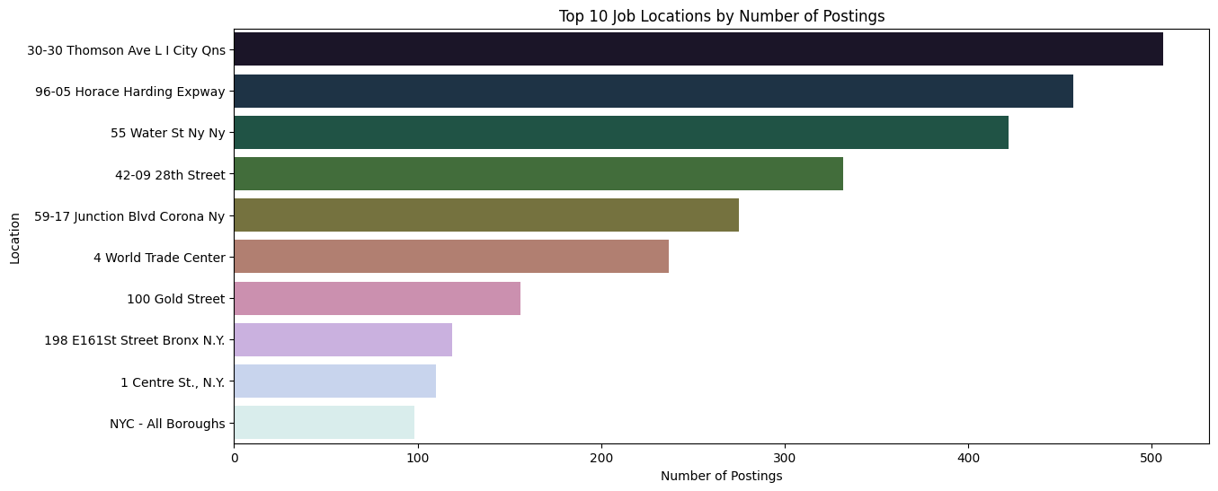
Figure 1.5. Top 10 Job Locations.
The analysis also considers job location distribution, with certain locations, such as Thomson Ave, Horace Harding Expressway, and Water St., being major hubs for job postings. This concentration of job postings suggests that specific areas may serve as primary centers for public sector employment in NYC.

Slide 19
Data Visualization and Results
02
Bivariate Analysis

Slide 20
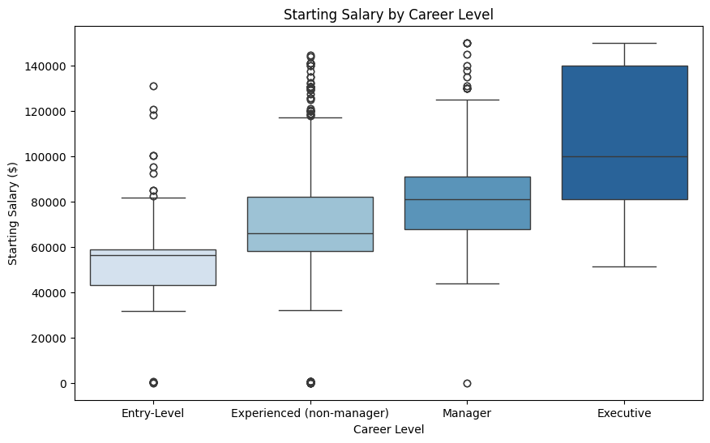
Figure 2.1. Starting Salary by Career Level
An analysis of starting salaries by career level shows that, as expected, higher career levels come with higher starting salaries. Executive roles offer the highest starting pay, followed by managerial roles. This trend matches industry norms, where senior roles get higher pay because of their added responsibilities.

Slide 21
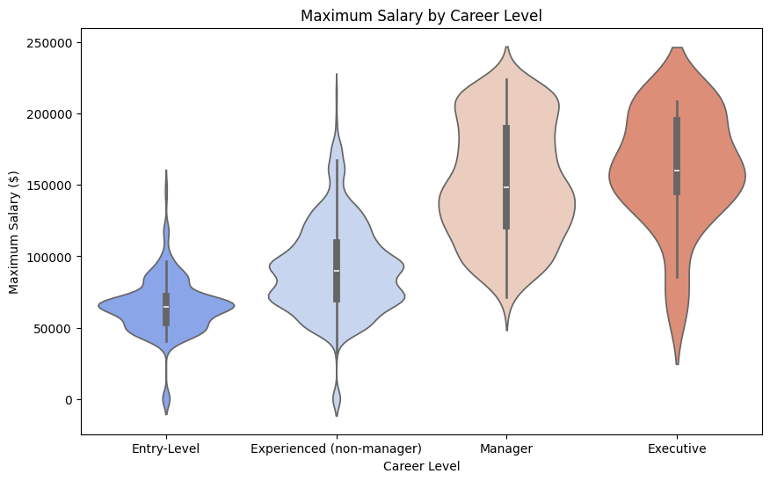
Figure 2.2. Maximum Salary by Career Level
A review of the maximum salary distributions shows that executive roles have the highest earning potential, with a wide range of salaries, while entry-level roles have a smaller salary range, showing limited earning potential.

Slide 22
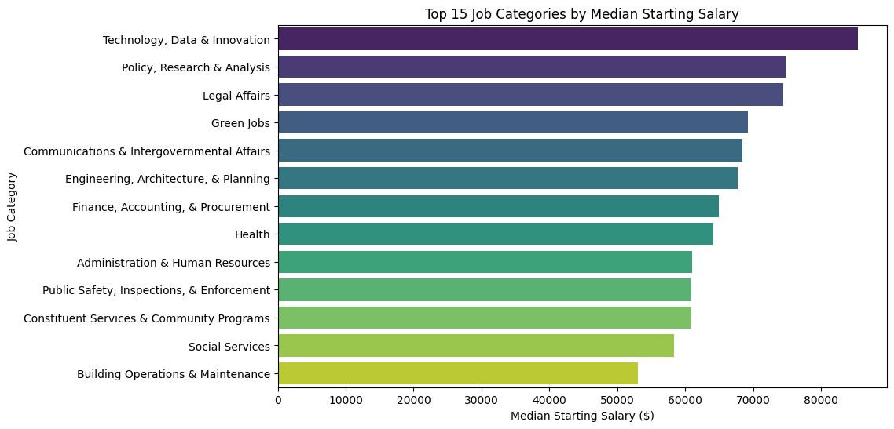
Figure 2.3. Top 10 Job Categories with High Salary
This figure ranks the job categories based on the median starting salary, helping job seekers understand which fields are more financially rewarding. The analysis indicates that job categories involving technology, research, and legal expertise are the most financially rewarding, with starting salaries well above the median for other public sector roles. Conversely, categories related to social services and operations tend to offer lower starting salaries.

Slide 23
Data Visualization and Results
03
Multivariate Analysis

Slide 24
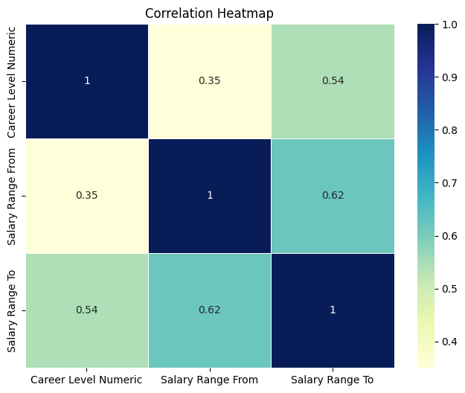
Figure 3.1. Correlation Heatmap
A correlation heatmap was used to assess relationships between career level, starting salary, and maximum salary. The results show a moderate positive correlation between career level and both starting and maximum salaries. This reinforces the idea that higher career levels lead to higher pay in NYC government jobs.

Slide 25
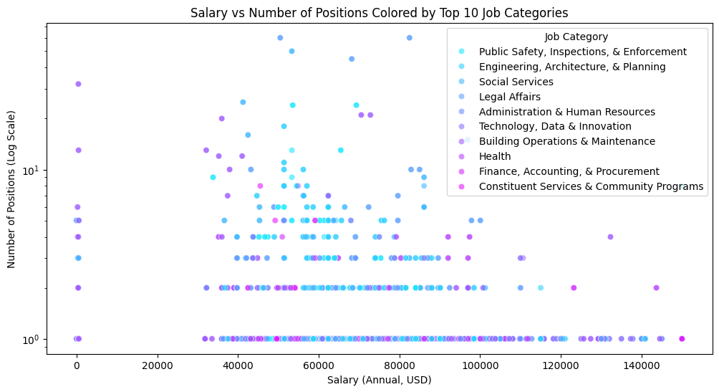
Figure 3.2. Relationship between Salary, Number of Positions and Job Categories
This analysis shows a trade-off between high salaries and job availability in NYC government jobs. Fields like Public Safety have numerous openings but generally offer moderate pay, whereas fields such as Legal Affairs provide higher salaries but fewer opportunities. Job seekers may need to balance their preferences between higher compensation and greater job availability depending on their career goals in the public sector.

Slide 26
Data Visualization and Results
04
Time Series Analysis

Slide 27
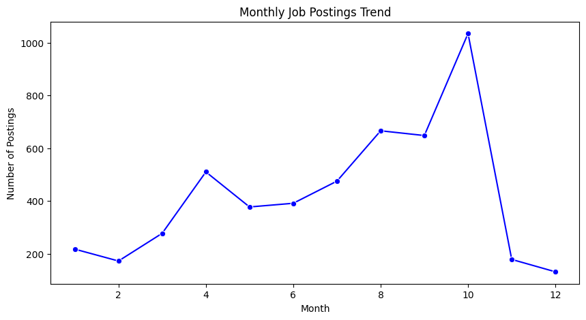
Figure 4.1. Monthly Job Postings Trend
The monthly trend of job postings shows seasonal patterns, with a noticeable peak in October. This suggests that hiring may be affected by the fiscal year or budget cycles, which can help job seekers understand the best times to apply.

Slide 28
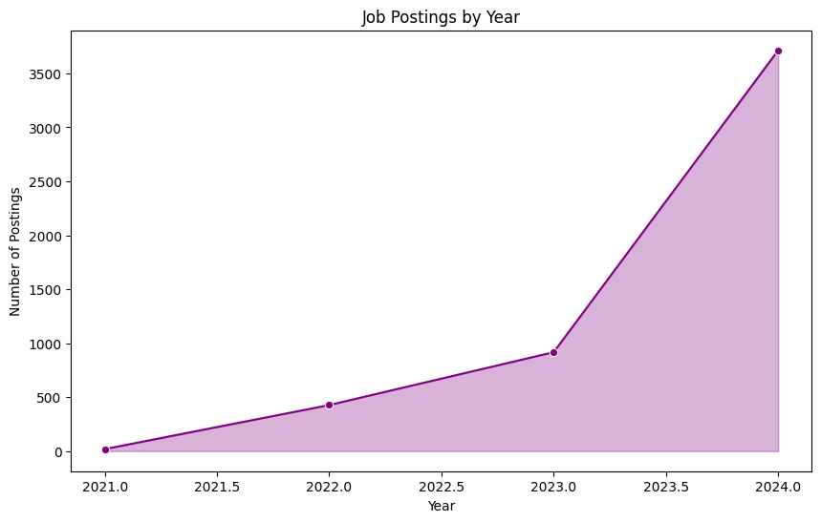
Figure 4.2 Job Postings by Year
The yearly trend analysis shows a sharp rise in job postings in 2024, likely reflecting more hiring or new projects. This suggests strong demand for government jobs in recent years.

Slide 29
Data Visualization and Results
05
Text Analysis

Slide 30
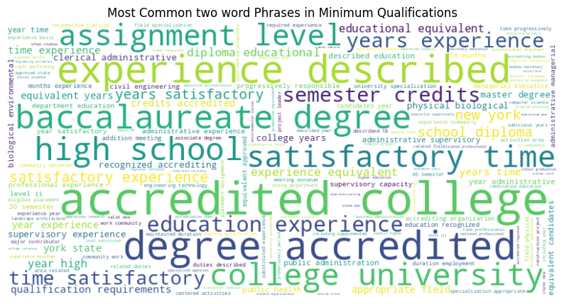
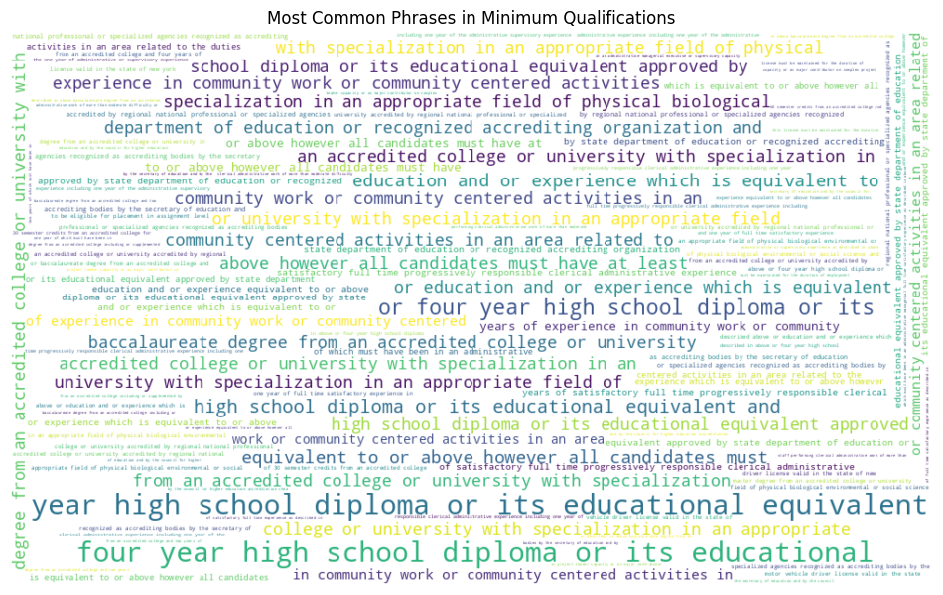
Figure 5.1. Most Common Phrases in Minimum Qualifications
An analysis of two word phrases and 8 word phrases in Minimum Qualifications shows that many NYC government jobs need formal education, with phrases like "Four year diploma," "accredited college," and "satisfactory experience" appearing often. A word cloud shows this emphasis on education and prior experience.

Slide 31
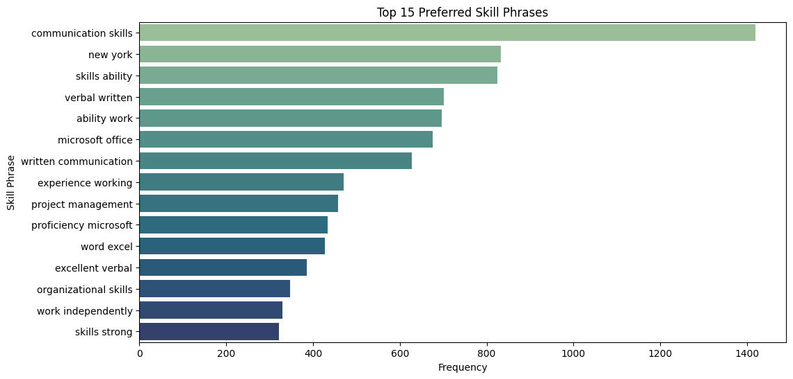
Figure 5.2. Top 15 Preferred Skill Phrases
The top skills highlighted in the analysis are "written communication skills", "verbal written communication" "excellent verbal and written" and "proficiency in Microsoft Office." These skills are commonly requested across many roles, emphasizing the importance of effective communication and digital proficiency for NYC government jobs.

Slide 32
Conclusion
High Demand Fields:
Significant demand in Engineering, Architecture & Planning.
Other important fields like Health, Legal Affairs, and Social Services show the city’s need for professionals to support public health and welfare.
Key Hiring Agencies:
Department of Environmental Protection and Health/Mental Hygiene are leading employers.
Focused on environmental and health services.
Experience Preferred:
Majority of postings are for experienced non-manager roles.
Fewer entry-level opportunities show preference for candidates with relevant experience.

Slide 33
Conclusion
Salary Patterns:
Pay increases with career level.
Most roles offer moderate salaries ($50,000 - $100,000).
Technical, Research and Legal provide the best salary.
Skill Requirements:
Desired qualifications include educational degrees, communication skills, and Microsoft Office proficiency.
Hiring Trends:
Postings peak in October, likely due to fiscal cycles.
Recent years show a steady increase, indicating more hiring.
Guidance for Job Seekers:
Insights help align skills and application timing with public sector opportunities.

Slide 34
Recommendations and Future Directions
Enhanced Skill Matching:
Explore specific skill gaps in communication and Microsoft Office among applicants.
Collaborate with educational institutions for targeted training programs.
Seasonal Hiring Patterns:
Analyze seasonal or cyclical hiring trends over several years.
Helps job seekers better plan when to apply.
Predictive Hiring Needs:
Develop predictive models to forecast future hiring needs.
Assist policymakers in aligning resources and recruitment efforts.
Job Flexibility and Benefits:
Explore flexibility options like remote work, health benefits, and leave policies.
Help job seekers make decisions that align with personal needs beyond salary.

Slide 35
References
1. “The Employment Situation”, News Release, Bureau of Labor Statistics,U.S. Department of Labor, November 1, 2024.
2. “Skills-First: Reimagining the labor Market and Breaking Down Barriers”, LinkedIn Economic Graph, 2023.
3. Intro to Exploratory data analysis (EDA) in Python https://www.kaggle.com/code/imoore/intro-to-exploratory-data-analysis-eda-in-python
4. EDA | Exploratory Data Analysis in Python
https://www.geeksforgeeks.org/exploratory-data-analysis-in-python/

Slide 36

GitHub
https://github.com/zaidzr3/EDA_Python
👆 Click to Visit

